Slide 1
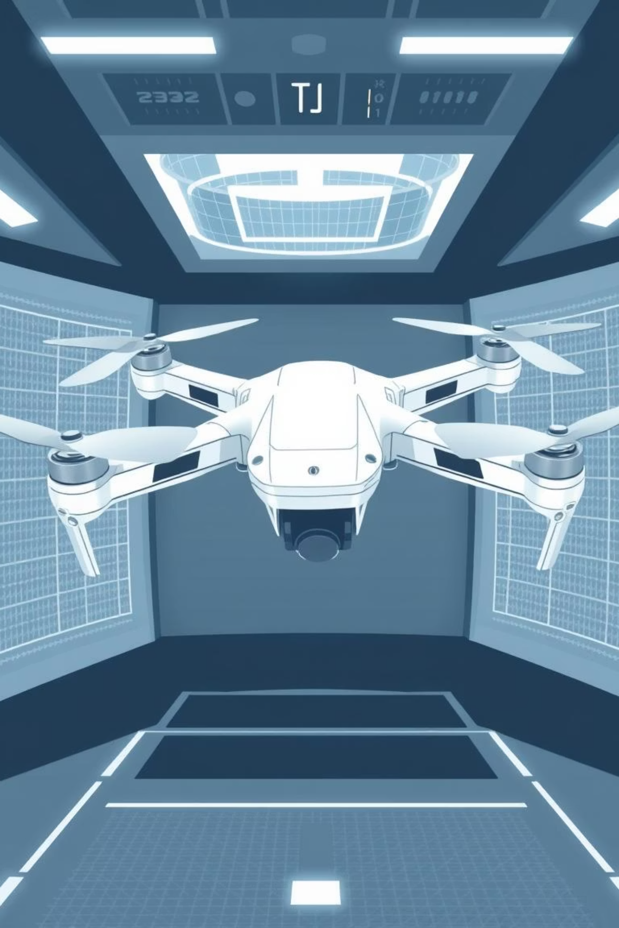
UNMANNED AERIAL VEHICLES (UAV/DRONE) AND SIMULATION WITH MATLAB/SIMULINK
Prepared by: …
Institution / Course: …
Date: …
Overview of UAV technology, its operation, and simulation environment

Slide 2
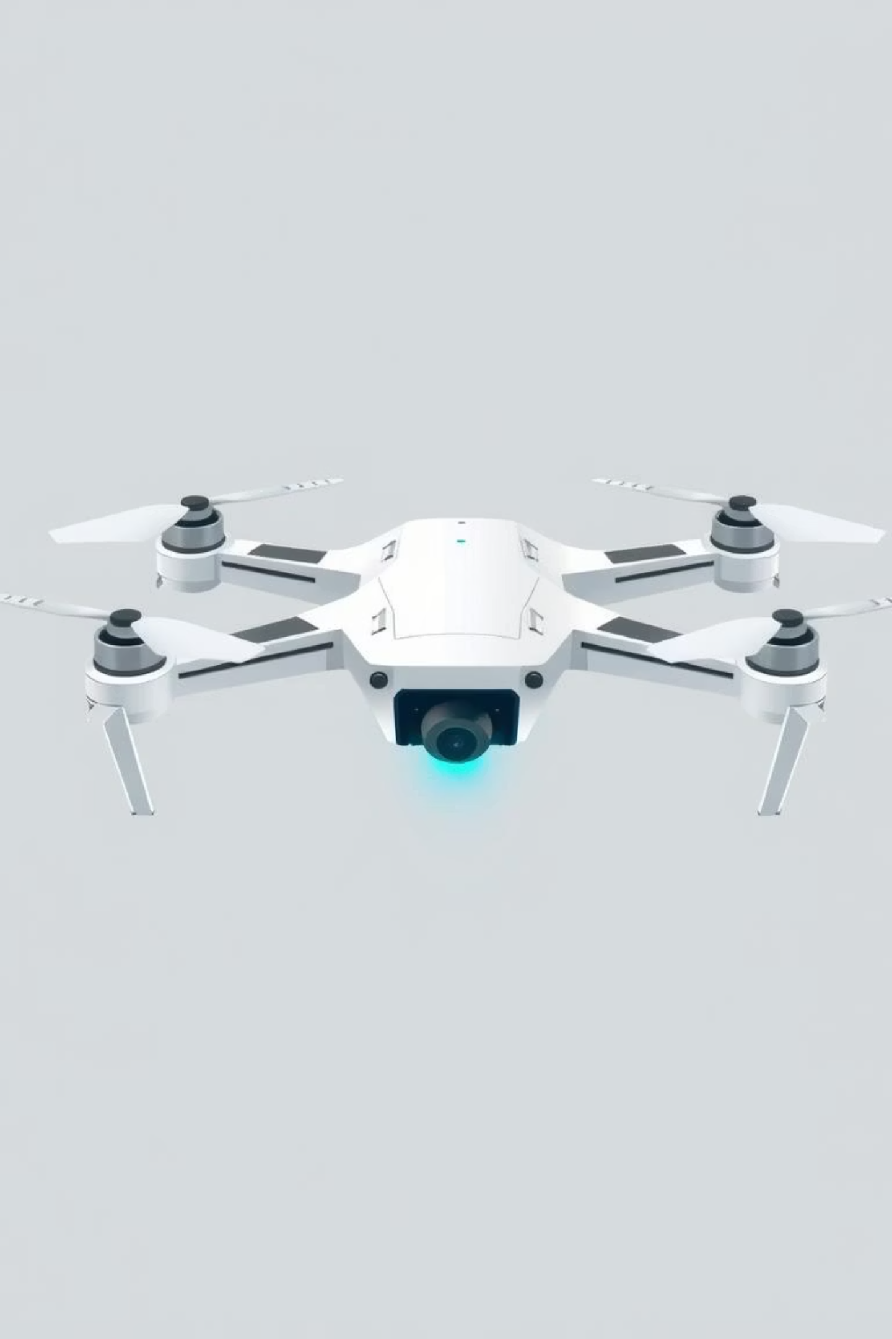
Slide 2 – Introduction to UAV
UAV stands for Unmanned Aerial Vehicle, commonly referred to as a Drone
Aircraft without an onboard human pilot
Controlled either remotely by operators or autonomously via onboard systems
Increasingly important in both civilian industries and military operations
Represent one of the most dynamic fields in modern aerospace technology

Slide 3
Slide 3 – Historical Development
WWI and WWII
1990s
Early prototypes for reconnaissance and target practice
Introduction of Predator drone – long-endurance reconnaissance and combat
1
2
3
4
Cold War era
2000s – Present
Rapid military development, mainly for surveillance
Expansion into civilian, commercial, and research applications
UAVs evolved from simple remotely piloted aircraft to highly autonomous systems

Slide 4
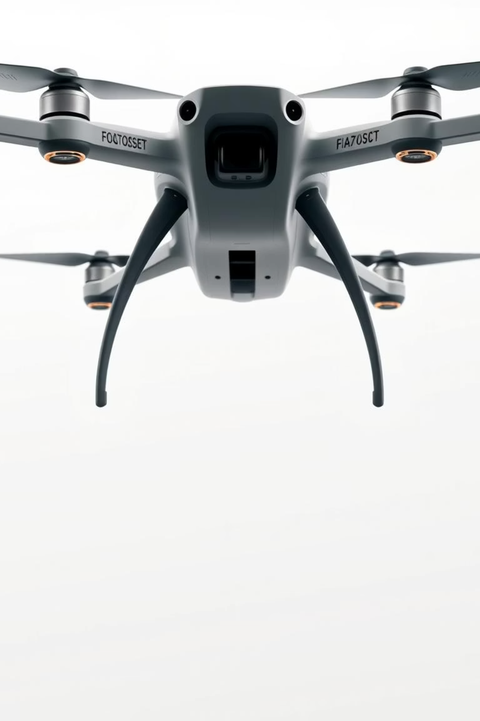
Slide 4 – UAV Classification
By Size
By Structure
Nano / Micro UAVs (indoor, hobby)
Fixed-wing (long endurance, high efficiency)
Mini UAVs (research, agriculture)
Rotary-wing / Multirotor (maneuverability, hovering)
Medium and Large UAVs (logistics, military)
Hybrid systems (VTOL – vertical take-off and landing)
By Operation Range: Short, Medium, and Long-endurance UAVs

Slide 5





Slide 5 – UAV Applications
Agriculture
Logistics
Military
crop monitoring, pesticide spraying, precision farming
parcel delivery (Amazon Prime Air, Zipline)
surveillance, reconnaissance, precision strikes
Emergency Services
Scientific Research
disaster relief, fire detection, search & rescue
mapping, climate monitoring, wildlife observation
UAVs combine cost-effectiveness, accessibility, and safety in dangerous environments

Slide 6
Slide 6 – UAV Basic Components
Airframe/Structure
Motors & Propellers
lightweight carbon fiber, aluminum, or composite materials
generate lift and thrust for flight
Electronic Speed Controllers (ESCs)
Power Supply
regulate motor speeds
batteries (Li-Po) or hybrid fuel systems
Flight Controller (FCU)
Sensors
brain of UAV, processes data and commands
GPS, IMU, camera, lidar, barometer, ultrasonic sensors

Slide 7
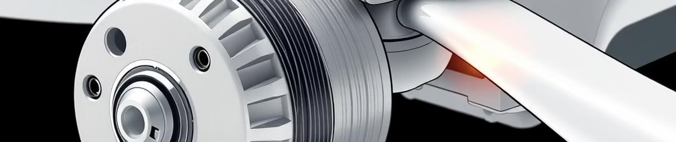
Slide 7 – Motor and Propeller System
Brushless DC Motors (BLDC): reliable, efficient, high power-to-weight ratio
Propellers: designed to optimize thrust, lift, and stability
Quadrotor system: differential rotor speeds produce roll, pitch, yaw, and altitude changes
Energy efficiency and thrust control are critical for endurance

Slide 8



Slide 8 – Flight Control Mechanism
Roll
Pitch
tilt left/right (controlled by opposite propellers)
tilt forward/backward (front vs rear propellers)
Yaw
Throttle
rotation around vertical axis (clockwise vs counterclockwise torque)
control of lift and altitude by increasing/decreasing power to all motors
Combination of these four controls enables full 3D maneuverability

Slide 9
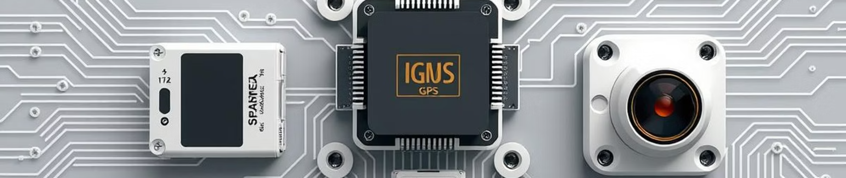
Slide 9 – UAV Sensors
IMU (Inertial Measurement Unit): accelerometer + gyroscope, provides orientation & stability
Ultrasonic Sensors: short-range distance measurements for landing or obstacle avoidance
GPS: global positioning and navigation, essential for long-distance flights
Barometer: altitude measurement for flight stability
Camera / Lidar / Infrared: object detection, terrain mapping, visual tracking

Slide 10
Slide 10 – UAV Communication System
Connection between UAV and Ground Control Station (GCS)
Communication methods
Radio frequencies (2.4GHz, 5.8GHz)
Wi-Fi links
Cellular 4G/5G connections for long-distance operations
Data exchanged includes
Control commands
Telemetry data (altitude, speed, battery level)
Real-time video streaming for FPV (First-Person View)

